Slide 2
Topics
Sequences
Introduction to Lists
List Slicing
Finding Items in Lists with the in Operator
List Methods and Useful Built-in Functions

Slide 3

Topics (cont’d.)
Copying Lists
Processing Lists
Two-Dimensional Lists
Tuples

Slide 4
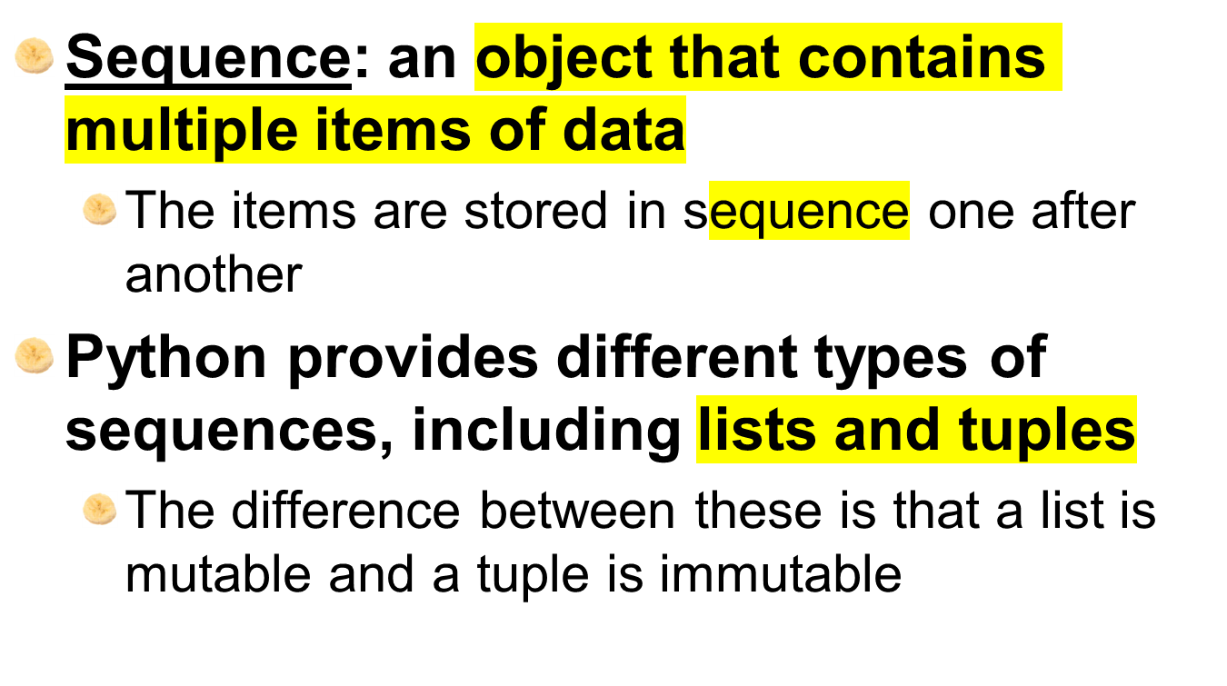
Sequences

Slide 5
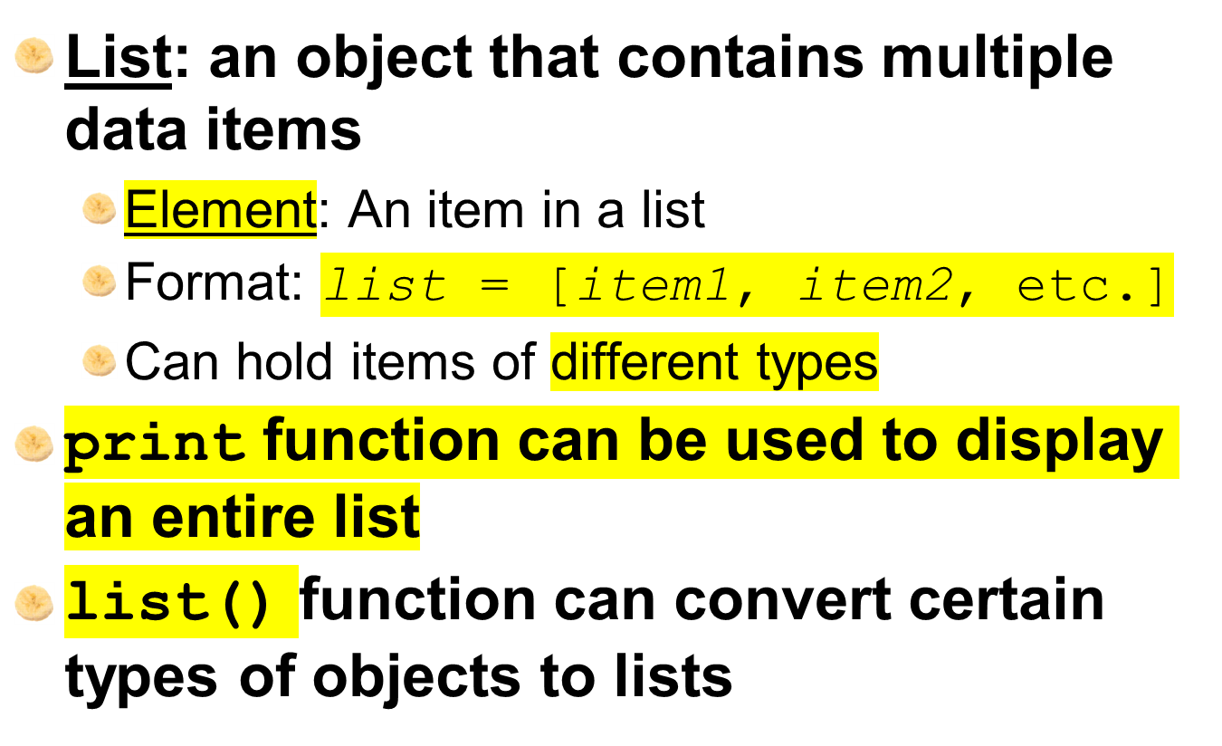
Introduction to Lists

Slide 6



Introduction to Lists (cont’d.)

Slide 7
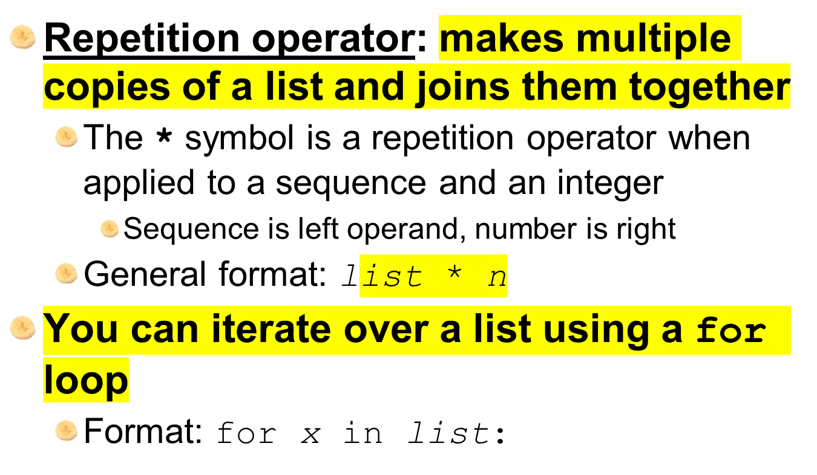
The Repetition Operator and Iterating over a List

Slide 8
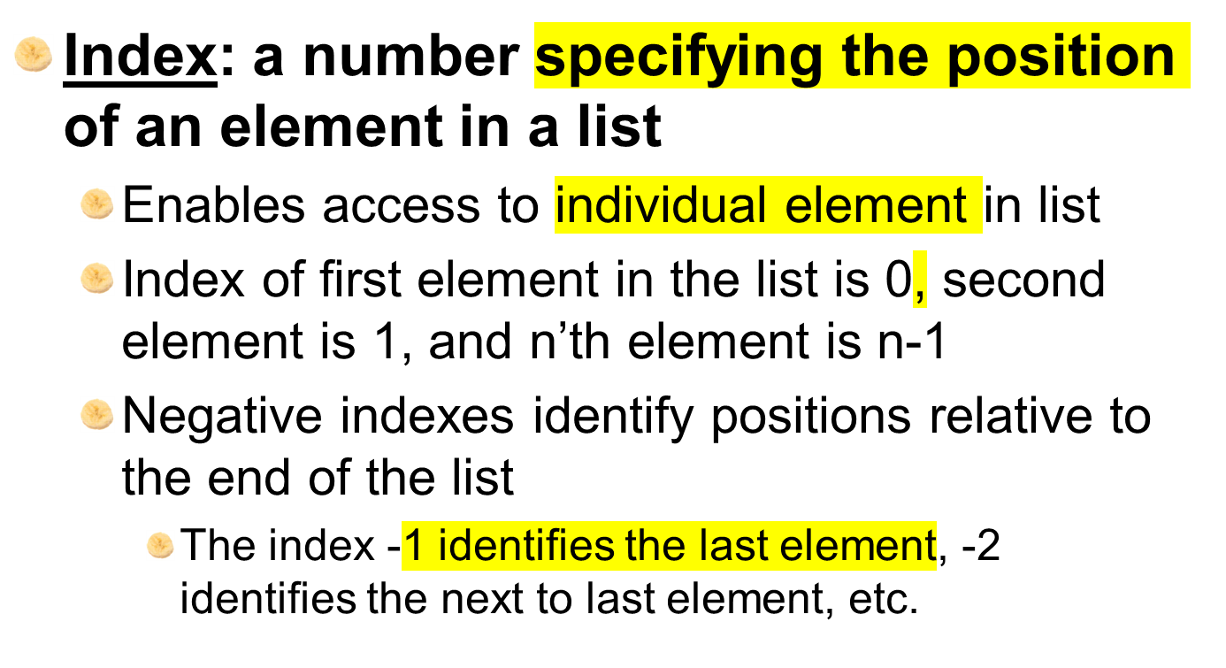
Indexing

Slide 9
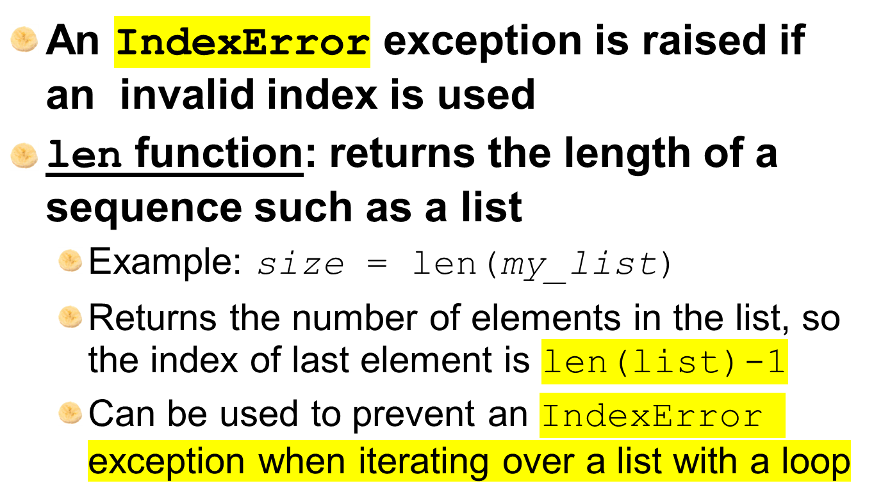
The len function

Slide 10
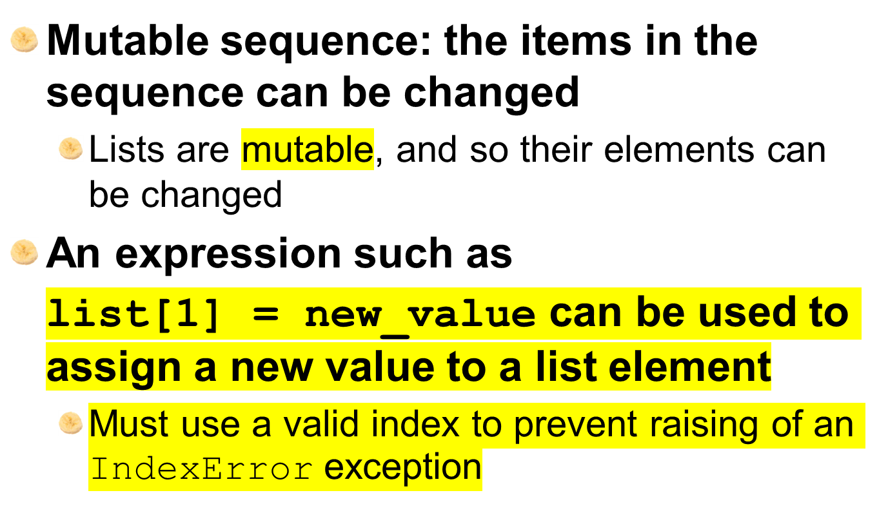
Lists Are Mutable

Slide 11
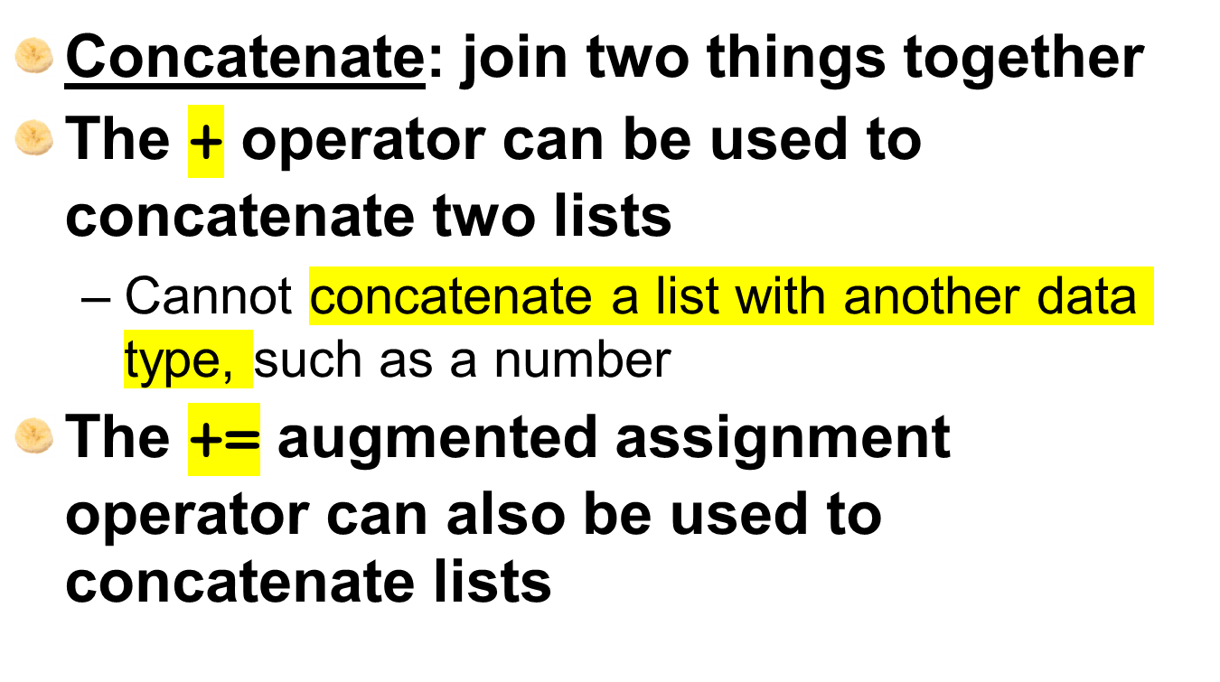
Concatenating Lists

Slide 12
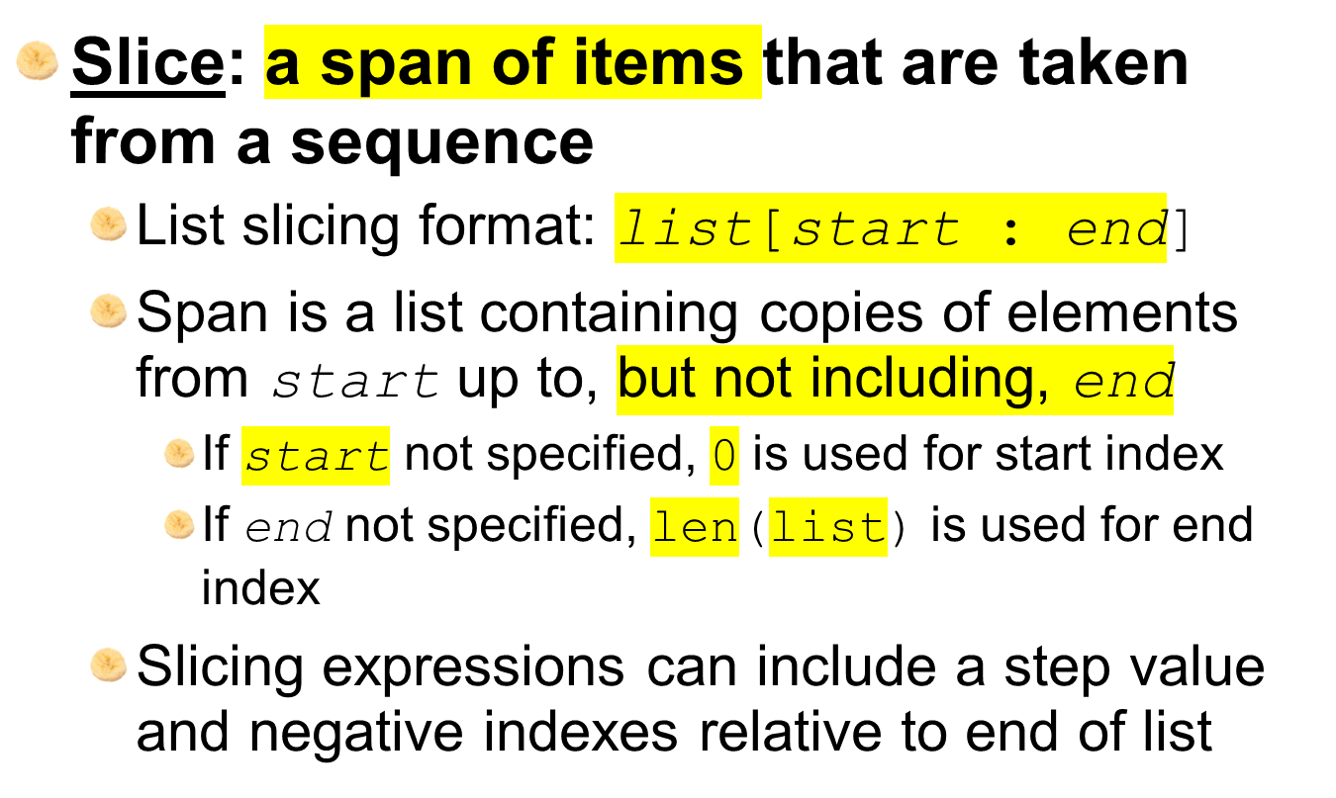
List Slicing

Slide 13
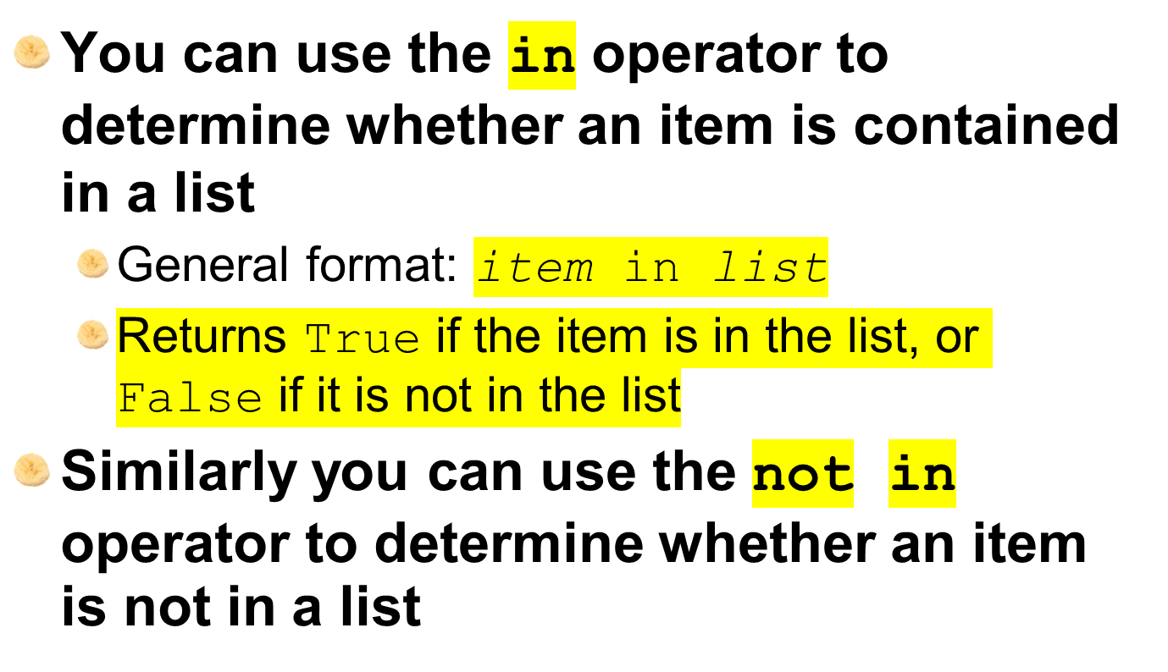
Finding Items in Lists with the in Operator

Slide 14
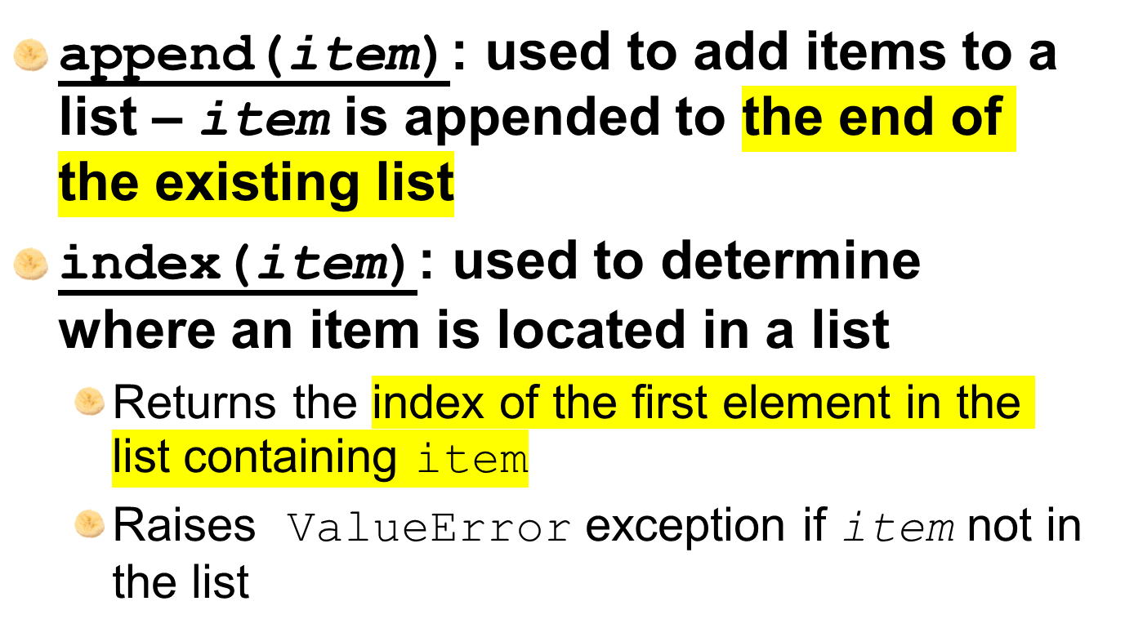
List Methods and Useful Built-in Functions

Slide 15
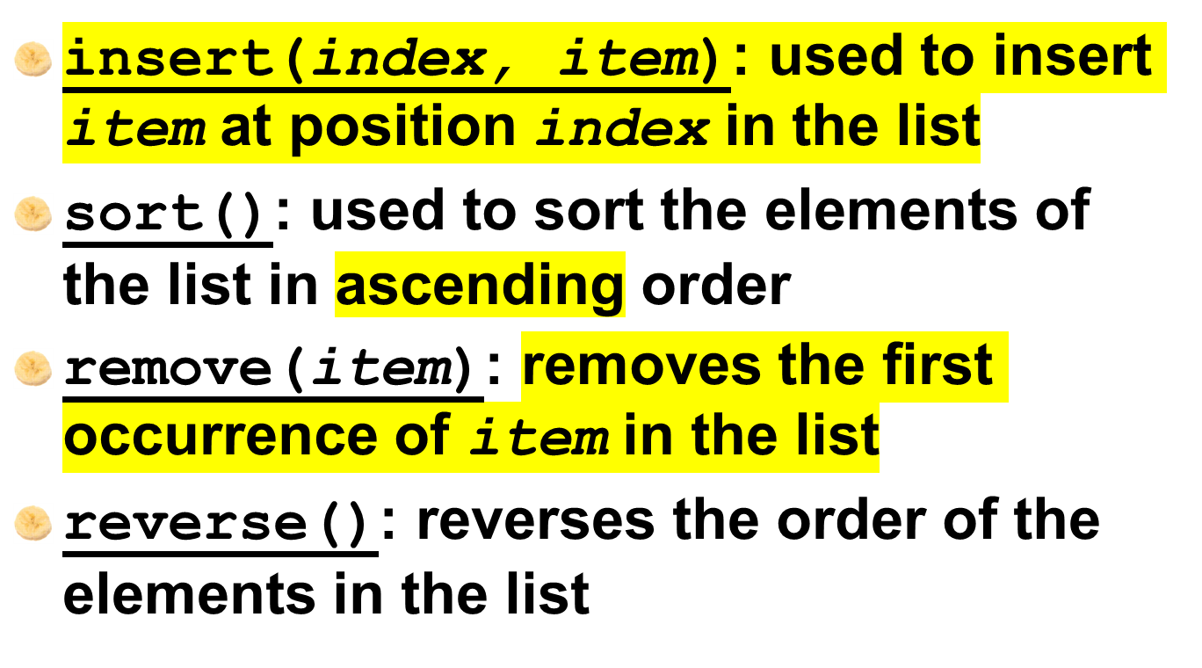
List Methods and Useful Built-in Functions (cont’d.)

Slide 16
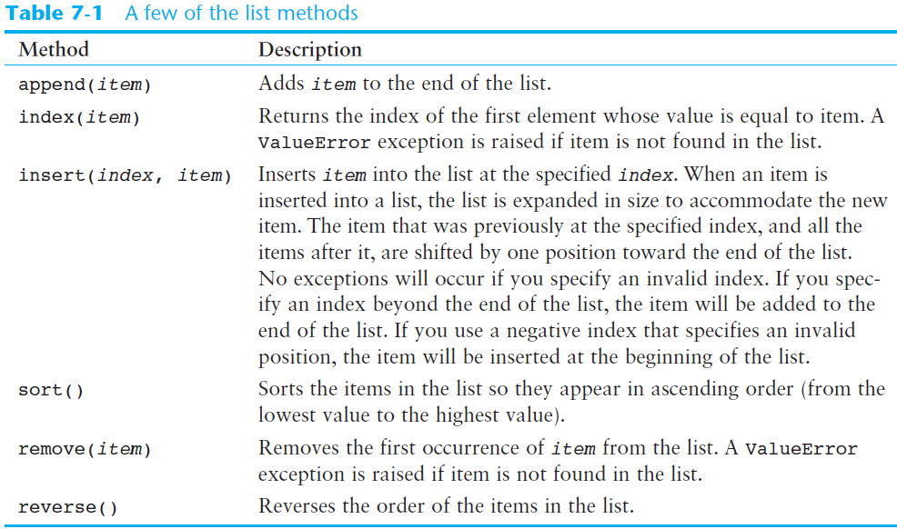

Slide 17
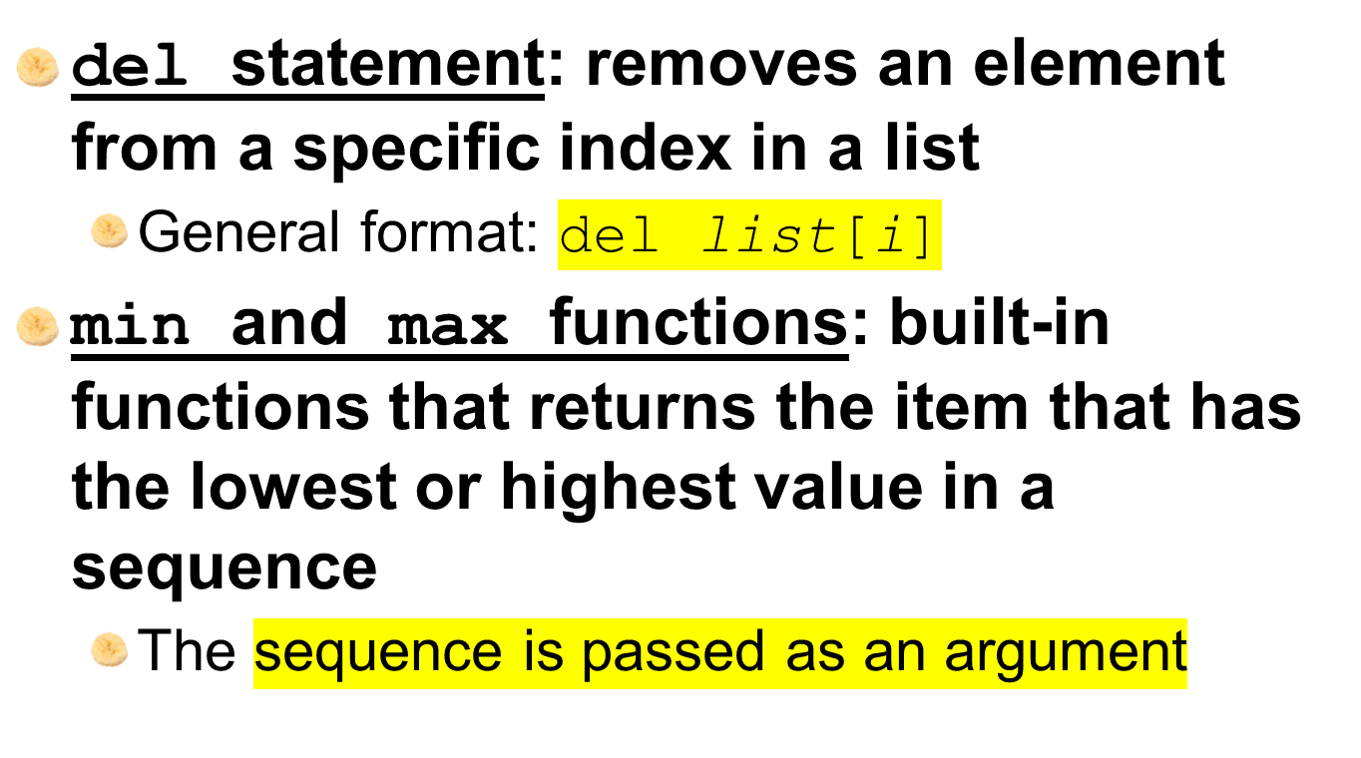
List Methods and Useful Built-in Functions (cont’d.)

Slide 18
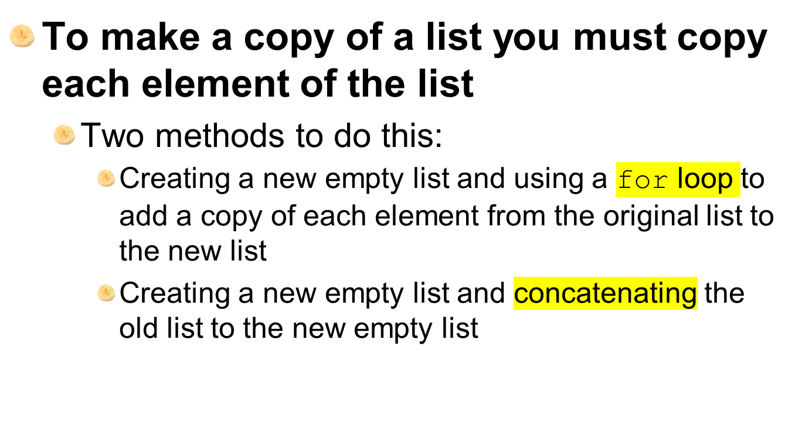
Copying Lists

Slide 19
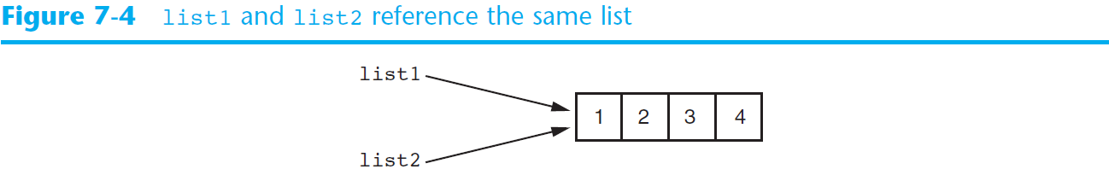
Copying Lists (cont’d.)

Slide 20
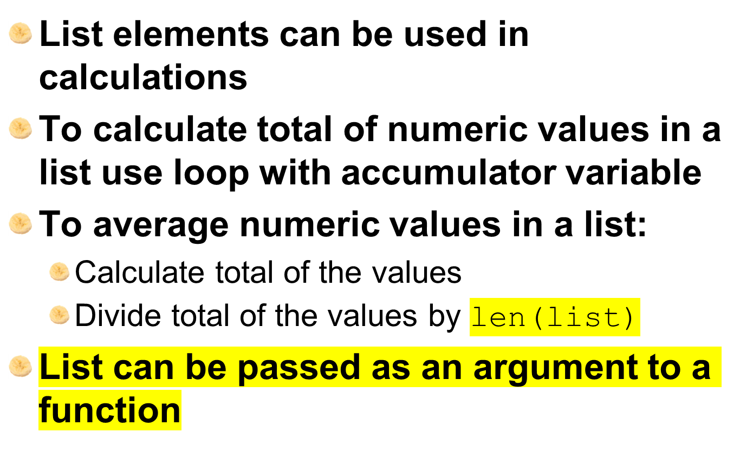
Processing Lists

Slide 21
Processing Lists (cont’d.)
A function can return a reference to a list
To save the contents of a list to a file:
  Use the file object’s writelines method
    Does not automatically write \n at then end of each item
  Use a for loop to write each element and \n
To read data from a file use the file object’s readlines method

Slide 22
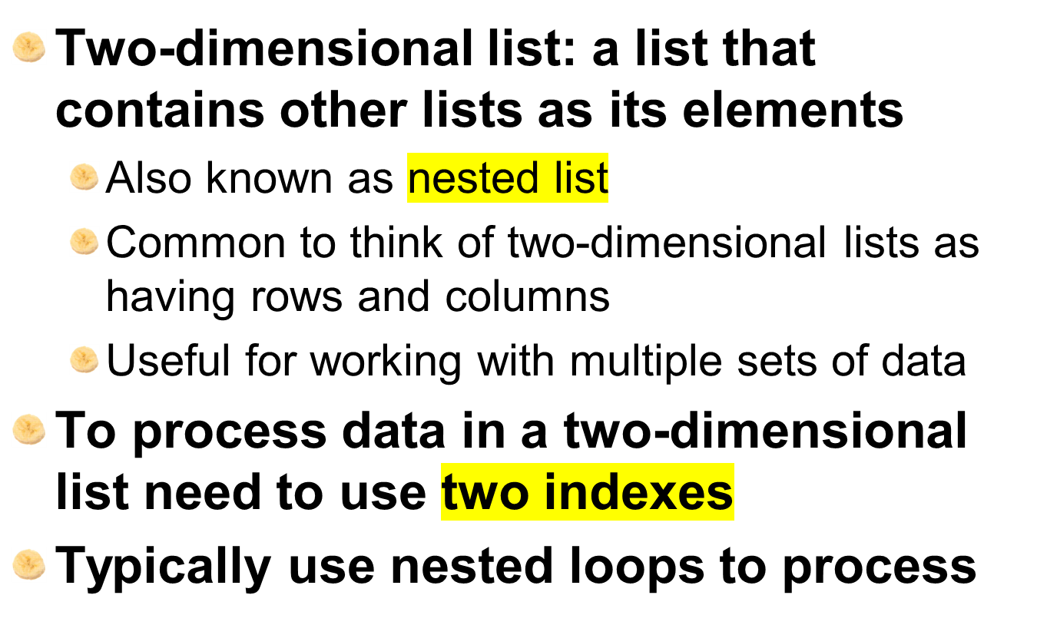
Two-Dimensional Lists

Slide 23
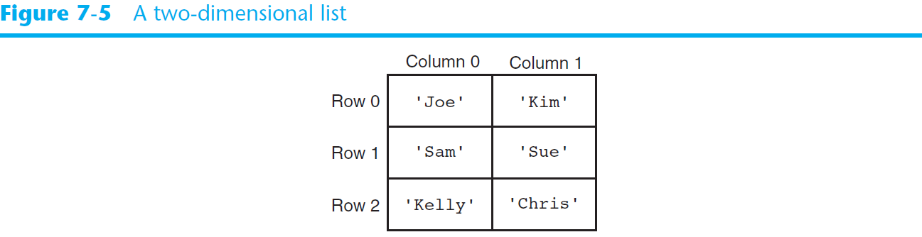
Two-Dimensional Lists (cont’d.)

Slide 24
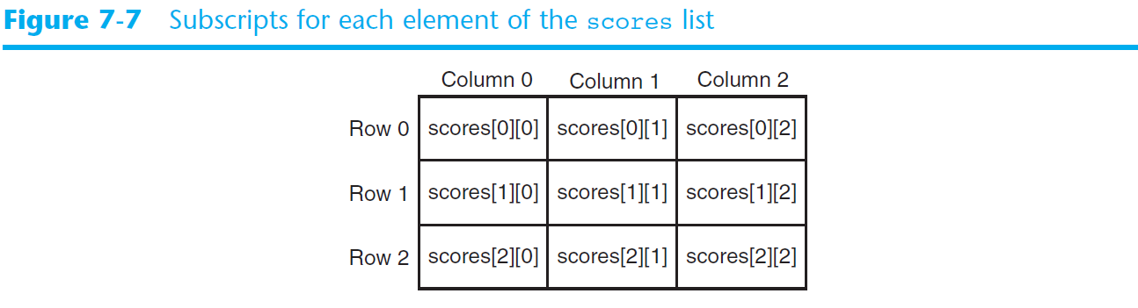
Two-Dimensional Lists (cont’d.)
Notes:
Rugged list, all rows can be different lengths

Slide 25
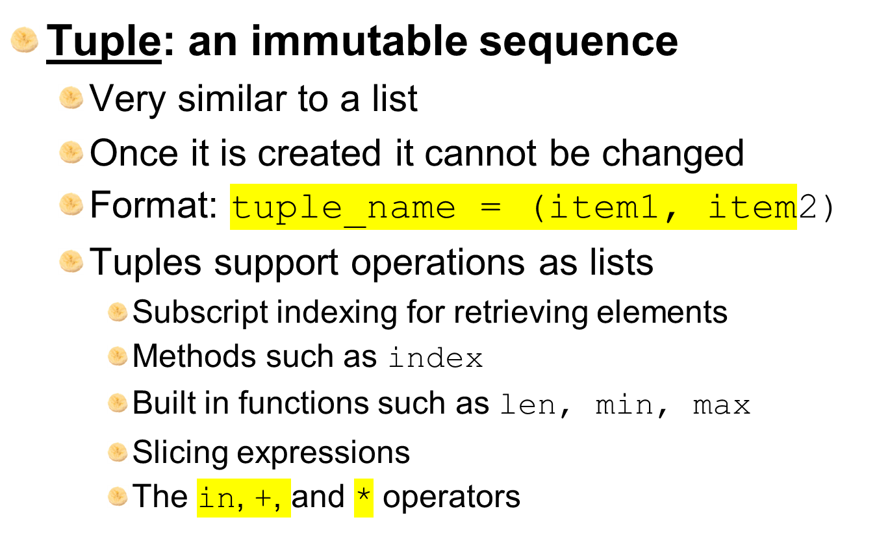
Tuples
Notes:
Orders of elements matter, data security is the reason why we prefer tuples over lists.
Data types of items can be different.

Slide 26
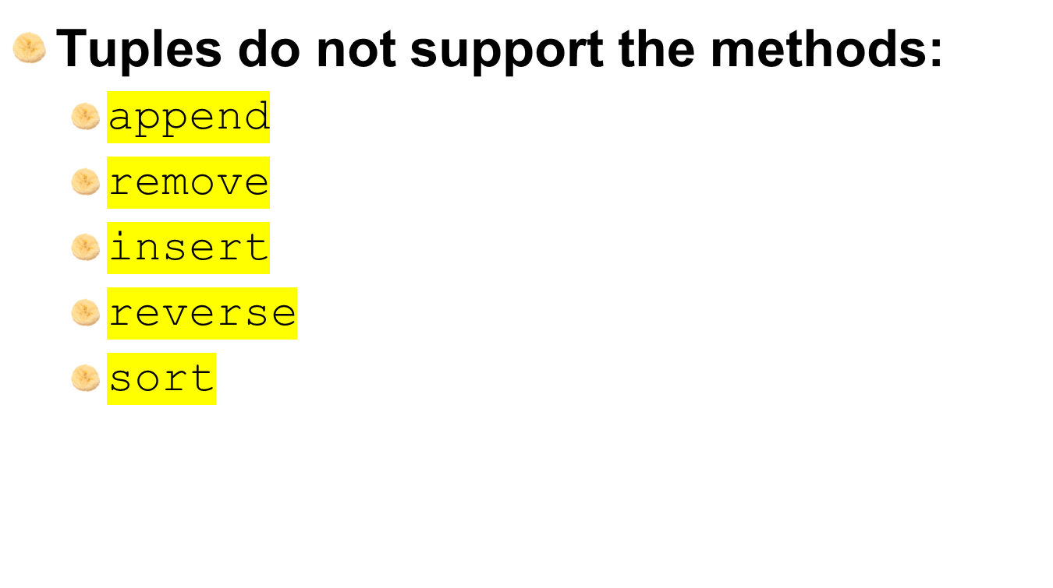
Tuples (cont’d.)
Notes:
Since its immutable and ORDER matters, we cant even sort.
The only difference betweem

Slide 27
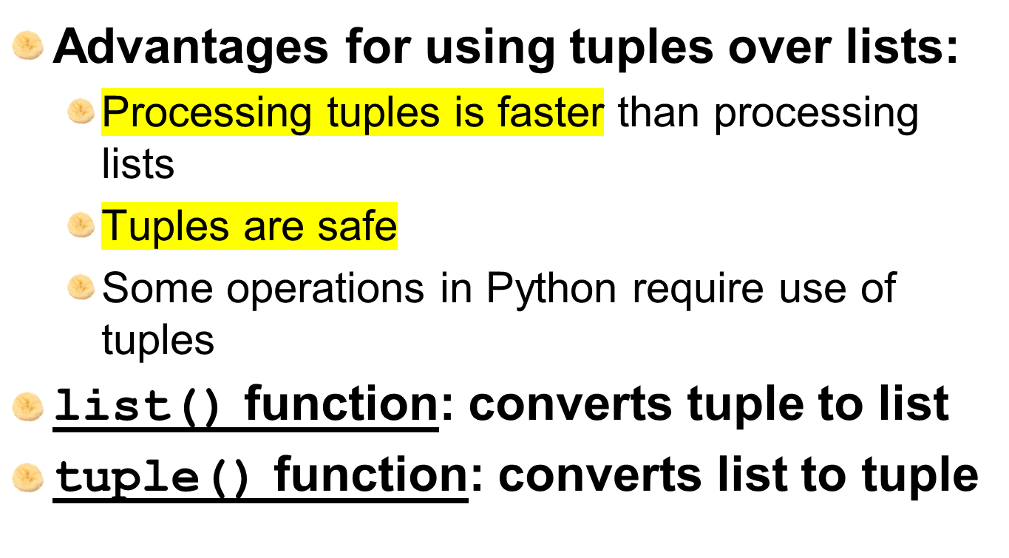
Tuples (cont’d.)

Slide 28
Summary
This chapter covered:
  Lists, including:
    Repetition and concatenation operators
    Indexing
    Techniques for processing lists
    Slicing and copying lists
    List methods and built-in functions for lists
    Two-dimensional lists
  Tuples, including:
    Immutability
    Difference from and advantages over lists

